Slide 1
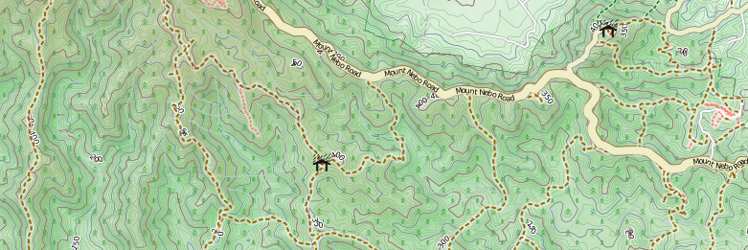
An introduction to OpenStreetMap for bushwalkers presented by David Dean http://www.dbdean.com

Slide 2

What is OpenStreetMap?
Geographic data
  For driving, riding, walking, boating, skiing, hiking, anything
Free
  Currently CC-BY-SA, moving to ODBL
Wiki-like editing
http://www.osm.org

Slide 3
Why not just use Google Maps?
or WhereIs/Yahoo/Bing Maps?
or whatever is on your GPS/Phone?
or commercial printed maps?

Slide 4


Updated rapidly
Google
OpenStreetMap

Slide 5



Not just for cars

Slide 6

Data freely available (and editable)

Slide 7
Worldwide activity
OSM 2008: A Year of Edits

Slide 8
Humanitarian OpenStreetMap Team
Haiti earthquake response

Slide 9

Haiti earthquake, Jan 2010

Slide 10

Haiti earthquake, Jan 2010
High-res imagery donated by many providers

Slide 11
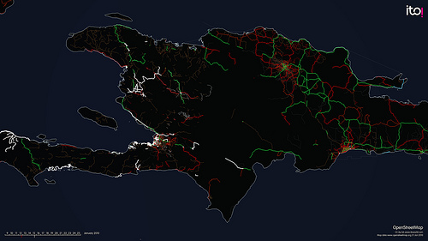
Haiti earthquake, Jan 2010
High-res imagery donated by many providers

Slide 12

"Hello guys, I just wanted to let you know that your work on improving the Haiti maps is really appreciated here. A few days ago I installed a version on my Garmin Oregon GPS and the result is impressive. It has already saved me and my driver from getting lost twice, and the alternative would have been long delays. In the coming days I will try to update our Red Cross relief GPS receivers with your map.” - Kjeld Jensen, Red Cross (IFRC)
World Bank Situation Room

Slide 13
OSM for bushwalking

Slide 14
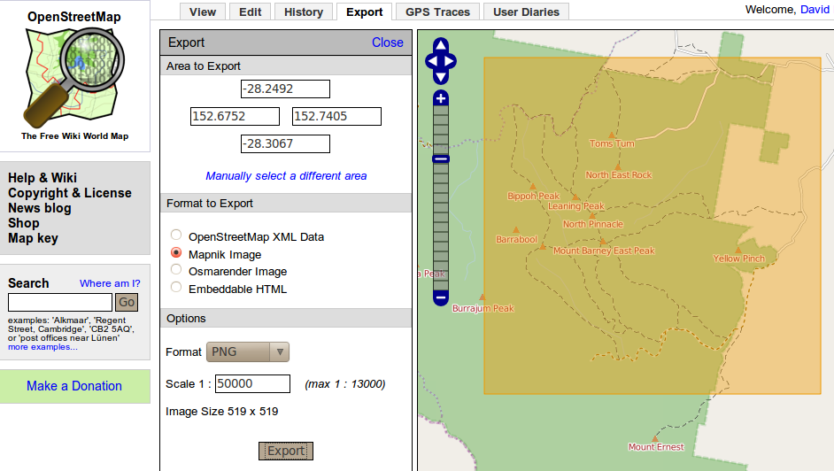
Download and print directly from http://osm.org

Slide 15
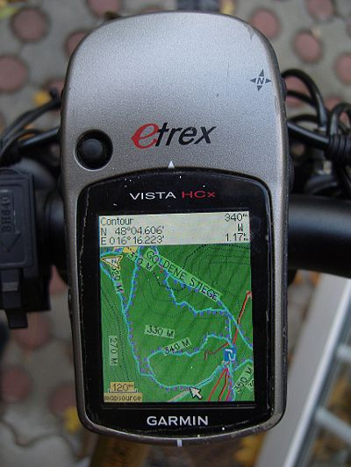
Or, load them onto your (Garmin) GPSR
Available to download from many locations, including http://openmtb.org
Or, you can roll your own with free tools

Slide 16
Bushwalking for OSM

Slide 17
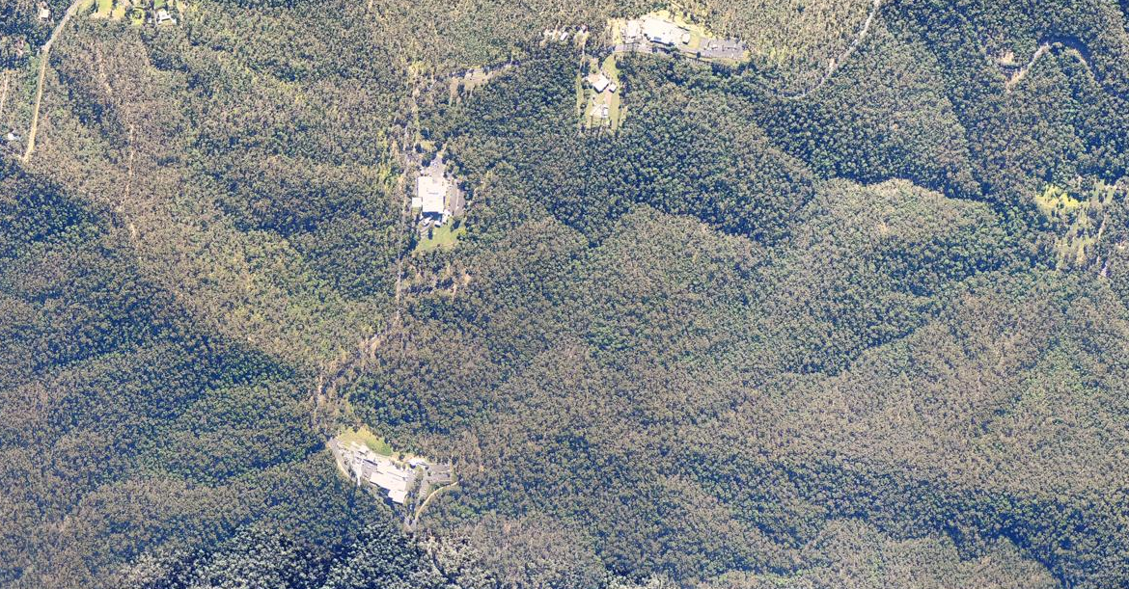
Aerial imagery is rarely useful
(or available)

Slide 18
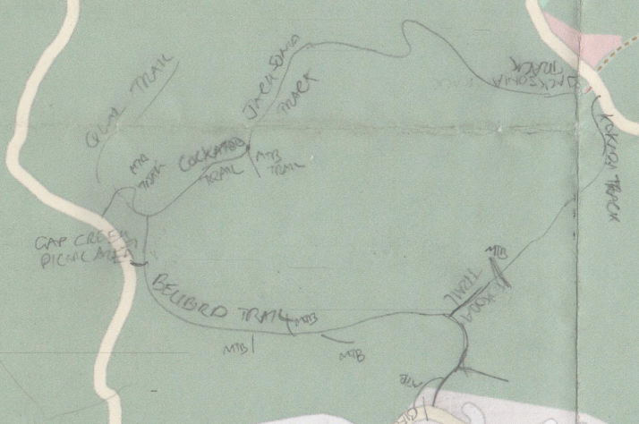

You need to go bushwalking
Take notes, →
record your trip,
and update the map from your notes
and GPS traces at home

Slide 19
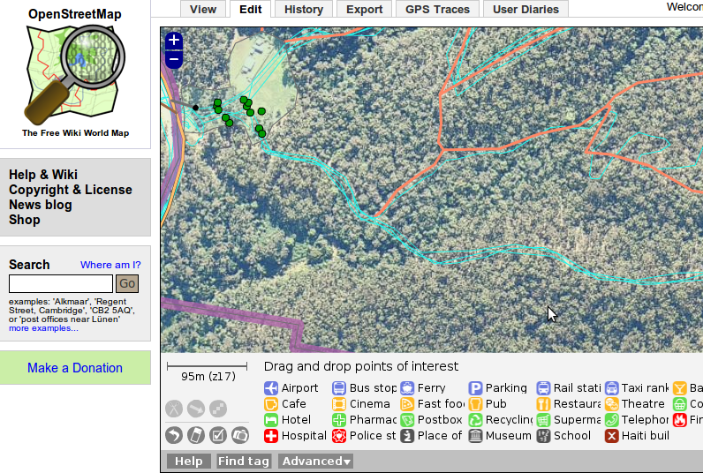
Putting trails on the map
Turn on
GPS traces

Slide 20
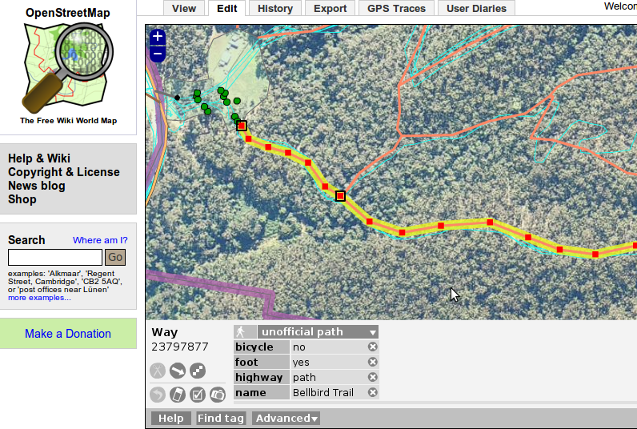
Putting trails on the map

Slide 21
What can you map when bushwalking?
Walking trails
Mountain-bike trails
Horse trails
Fire trails
Camp sites
Drinking water
Shelters
Rubbish bins
Stairs
Bridges
Rivers and Streams
Toilets
Nice views
Ground cover
Anything you want

Slide 22

Come to a mapping event to learn more
Brisbane mapping events occur monthly
  Alternate between mapping parties and meetups
Next event: OSM Mapping Meetup
  7pm Monday 16st August at Grange Library
  See http://wiki.osm.org/wiki/Brisbane
What is a mapping party?
  A group of people get together to map a large area in a single day
  Example: Macleay Island in November 2009

Slide 23
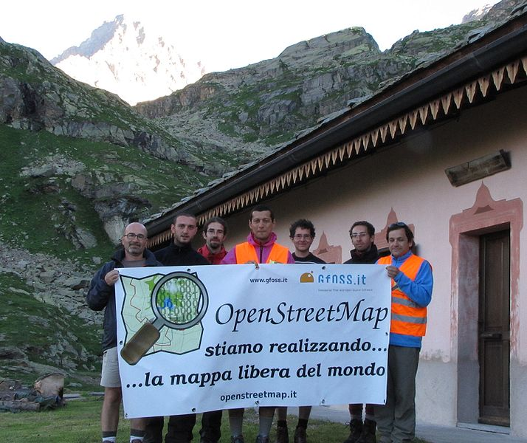
Questions/Suggestions?
Thanks for listening.
Mapping Party, Gran Paradiso National Park, Italy

Slide 24

Data representation
Geographic information is represented as
  Nodes
  Ways
    Ordered collections of nodes
    Closed ways can be areas
  Relations
    Ordered collections of ways and nodes
All can be tagged with any key/value pairs

Slide 25


No formal key/value ontology
Let freedom flourish!
Common tagging is encouraged
  Map Features wiki
  Editor presets
  Renderers
  OSMDoc
  Tagwatch

